Slide 1
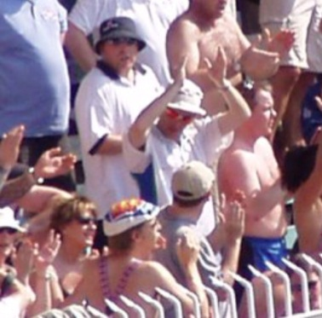
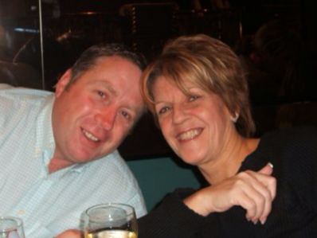
SUNDAY 26TH MAY 2019
CHARITY CRICKET GAME
2.00 START – Elford Cricket Club - B79 9DE
Elford Cricket Club
V
The Rest of
AUCTION
RAFFLE
ALL PROCEEDS TO THE PBC FOUNDATION
Donations can also be made via ‘’Just Giving’’ ‘’Sandra Bozward Memorial Cricket Day’’
All welcome !
For any further information contact Boz 07584 800260
Directions - Follow signs for Church, follow road to the right, cricket club on right, parking behind club house

